Slide 1
Travel Package Purchase Prediction
Sandhya Nair
Feb 2021

Slide 2
Objective
Explore and visualize the dataset.
To predict which customers will purchase the long term travel package
Which variables are most significant.
Build Models using Bagging & Boosting to predict whether a person will take travel package or not
Generate a set of insights and recommendations that will help the business to understand which segment of customers should be targeted more.

Slide 3
Data Information
CustomerID: Unique customer ID
ProdTaken: Product taken flag
Age: Age of customer
PreferredLoginDevice: Preferred login device of the customer in last month
CityTier: City tier
Occupation: Occupation of customer
Gender: Gender of customer
NumberOfPersonVisited: Total number of person came with customer
PreferredPropertyStar: Preferred hotel property rating by customer
MaritalStatus: Marital status of customer
NumberOfTrips: Average number of the trip in a year by customer
Passport: Customer passport flag
OwnCar: Customers owns a car flag
NumberOfChildrenVisited: Total number of children visit with customer

Slide 4
Data Information
Designation: Designation of the customer in the current organization
MonthlyIncome: Gross monthly income of the customer
Customer interaction data: (Used for only analysis purpose and not for modelling)
PitchSatisfactionScore: Sales pitch satisfactory score
ProductPitched: Product pitched by a salesperson
NumberOfFollowups: Total number of follow up has been done by sales person after sales pitch
DurationOfPitch: Duration of the pitch by a salesman to customer
There are 4888 rows and 20 columns for the data set

Slide 5
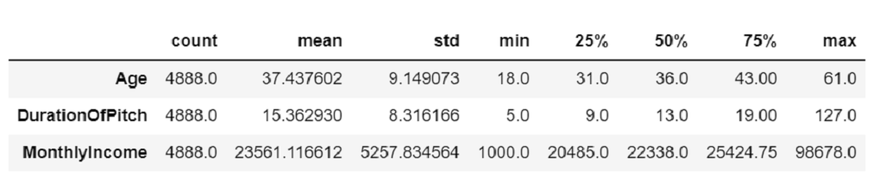
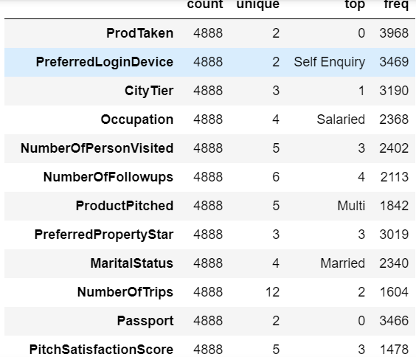
Exploratory Data Analysis
We can see that the age of the
customers vary from 18 years to
61 years
Maximum duration of Pitch is 127
We can see that most of the customers came
into the company's contact by doing a self inquiry
Most of the customers have Salaried occupation
type ,are Male and are Married
Most of the customers have not taken the travel
package in the previous campaign
Most of the customers prefer 3 star property
Most of the customers have taken 2 trips per year
ProdTaken is our target variable

Slide 6
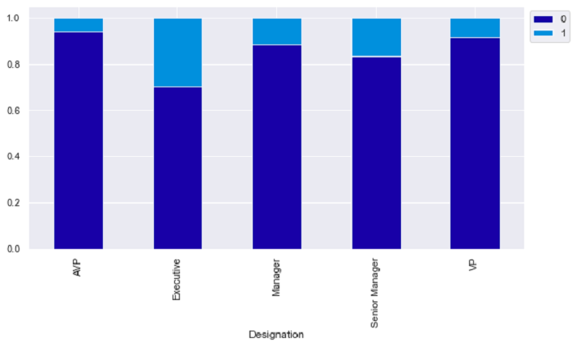
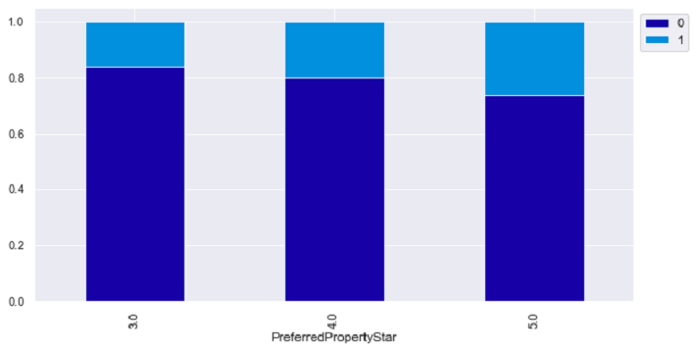
Exploratory Data Analysis
Those who travel 7 or 8 trips per year has more chance of
purchasing the travel package.Also having a passport showed chances
of purchasing the package
Factors that did not have much effect on travel package
purchase was Gender,number of children visiting, having a car etc.
In terms of customer interaction data customers mostly purchased
the travel package :
When there is higher duration of pitch by salesman to the customer
When the PitchSatisfactionScore was 3 or 5
When the product pitched was Multi ,followed by standard product
When the number of follow ups was high, with number of followups
of 6 showing good chance of the customer purchasing the package

Slide 7
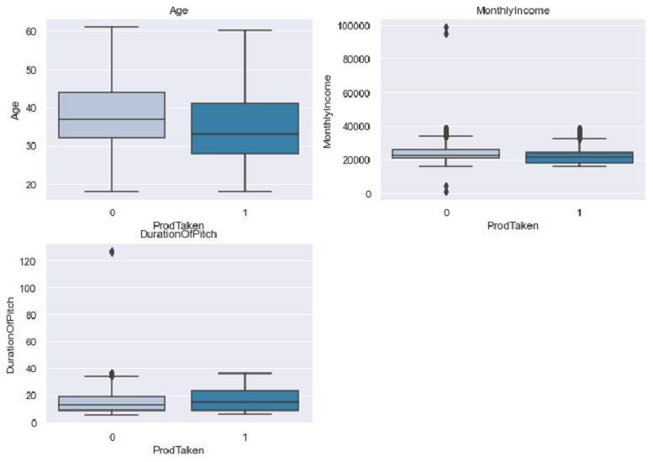
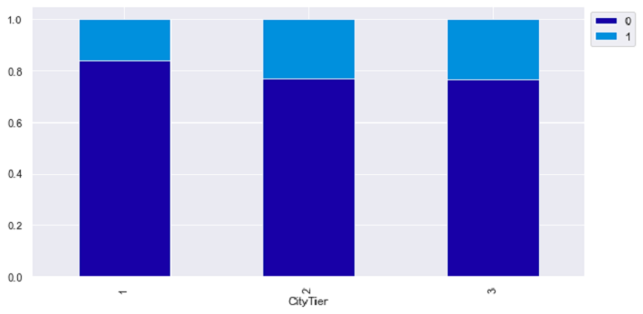
Exploratory Data Analysis
We can see that the holiday package has been taken
mostly by customers who are of less than 40 years of age,are
in executive positions
Customers who purchased travel package preferred 5
star rated properties and were mostly from city tier 2,3.
Also they were mostly who came into the company's contact
as company invited
In terms of occupation FreeLancer and Large Business owners
have higher chance of purchasing the travel package.
Also single and unmarried people has higher chance of
purchasing the travel package.Also customers having 2,3,4
persons travelling with them has more chance of buying the
travel package

Slide 8
Data Preprocessing
There were few rows of data where the Female column was displaying 'Fe Male',so combined those with the value Female
Missing Value: There were a lot of missing values in the data set which were treated on case by case basis
Outlier Detection: Outlier Detection was performed but based on analysis we have chosen not to treat them as those values seem to possible for the given data set
Data Type conversion of columns :Some of the columns were converted to category data type

Slide 9
Model Building Bagging - Decision Tree,Bagging Classifier,Random Forest
How to reduce this loss i.e need to reduce False Positives?
Company wants Precision to be maximized, greater the Precision higher the chances of minimizing false positives. Hence, the focus should be on increasing Precision or minimizing the false positives or in other words identifying the true positives,so that the company can focus on customers who will actually purchase the travel package and hence reduce marketing cost for the company
We Build the following Models initially:
Decision Tree
Bagging Classifier
Bagging Classifier with weighted Decision Tree
Random Forest
Random Forest with class weights

Slide 10
Model Building Steps & Evaluation Criteria
Data preparation
Partition the data into train and test set.
Build model on the train data.
Tune the model if required.
Test the data on test set.
Model evaluation criterion
Model can make wrong predictions as:
1. Predicting a customer will purchase travel package but the customer ultimately does not purchase the package
2. Predicting a customer will not purchase travel package but the customer purchases the travel package
Which case is more important?
Since the travel company want to reduce the marketing cost ,Predicting a customer will purchase travel package but the customer ultimately does not purchase the package is more important to the company so as to reduce the marketing cost and focus on customers who would actually buy the package

Slide 11
Model Performance Evaluation & Improvement - Bagging
Customer purchased package and model predicted customer will purchase travel package : True Positive (observed=1,predicted=1)
Customer did not purchase package and model predicted customer will purchase travel package : False Positive (observed=0,predicted=1)
Customer did not purchase package and model predicted customer will not purchase travel package : True Negative (observed=0,predicted=0)
Customer purchased package and model predicted customer will not purchase travel package : False Negative (observed=1,predicted=0)
Precision is the right metric for our case.Company wants Precision to be maximized, greater the Precision higher the chances of minimizing false positives. Hence, the focus should be on increasing Precision or minimizing the false positives or in other words identifying the true positives,so that the company can focus on customers who will actually purchase the travel package and hence reduce marketing cost for the company

Slide 12
Model Tuning using Grid Search
Grid search is a tuning technique that attempts to compute the optimum values of hyperparameters.
It is an exhaustive search that is performed on a the specific parameter values of a model.
The parameters of the estimator/model used to apply these methods are optimized by cross-validated grid-search over a parameter grid

Slide 13
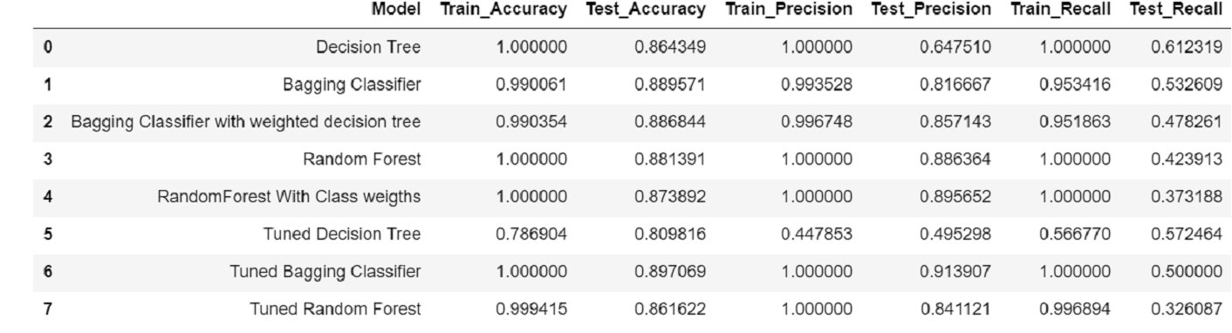
Model Comparison with and without Tuning
Comparison
Tuned Bagging classifier has the highest precision and good accuracy followed by Random Forest with class weights

Slide 14
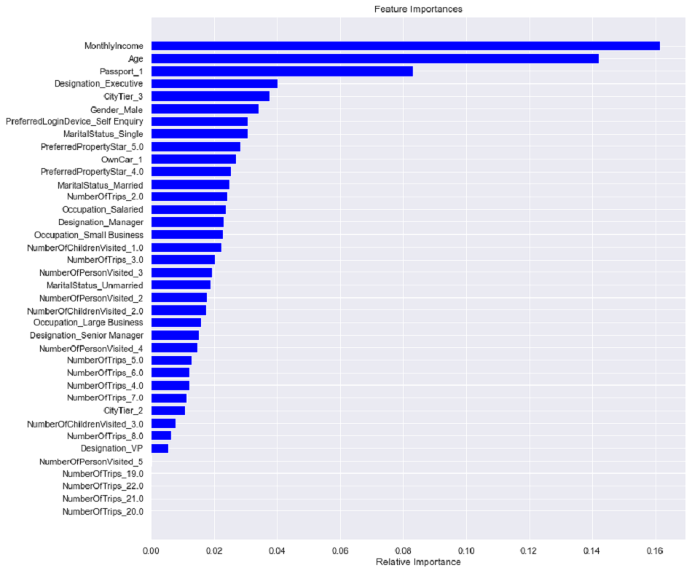
Feature Importance of Random Forest with class weights
Monthly Income,Age,having
passport,
Designation of Executive and
city_tier3 are top 5 features
selected by Random Forest with
class weights model

Slide 15
Model Building Boosting - AdaBoost, Gradient Boost,XGBoost Classifier
We Build the following models for Boosting
Ada Boost classifier
Gradient Boost classifier
XG Boost classifier

Slide 16
Model Performance Evaluation and Improvement-Boosting
Customer purchased package and model predicted customer will purchase travel package : True Positive (observed=1,predicted=1)
Customer did not purchase package and model predicted customer will purchase travel package : False Positive (observed=0,predicted=1)
Customer did not purchase package and model predicted customer will not purchase travel package : True Negative (observed=0,predicted=0)
Customer purchased package and model predicted customer will not purchase travel package : False Negative (observed=1,predicted=0)
Precision is the right metric for our case.Company wants Precision to be maximized, greater the Precision higher the chances of minimizing false positives. Hence, the focus should be on increasing Precision or minimizing the false positives or in other words identifying the true positives,so that the company can focus on customers who will actually purchase the travel package and hence reduce marketing cost for the company

Slide 17
Model Performance Improvement using Hyperparameter Tuning
Hyperparameter Tuning was performed for :
AdaBoost Classifier
Gradient Boost Classifier using AdaBoost Classifier as the estimator for initial predictions
Gradient Boost Classifier
XGBoost Classifier
Stacking Classifier
Stacking was performed with initial estimators as Decision tree,Random Forest & Gradient Boosting with XGB Classifier as the meta model

Slide 18
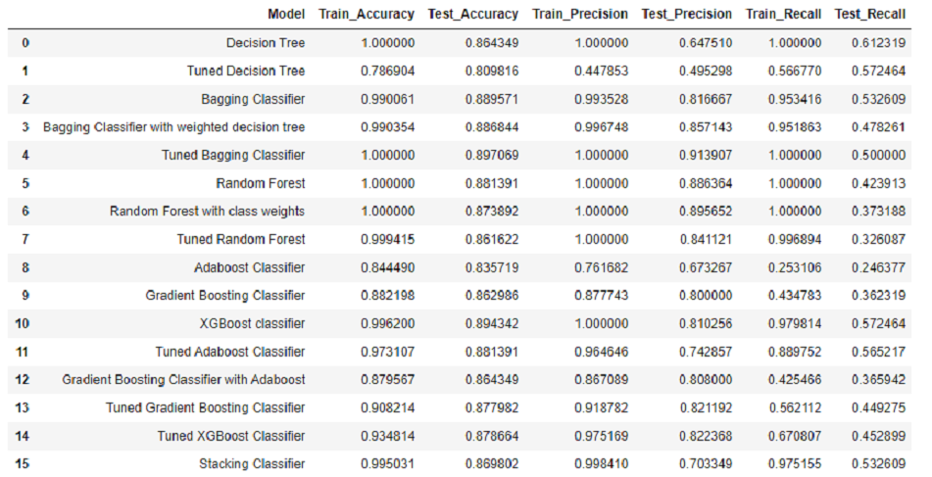
Comparison of all models
Tuned Bagging Classifier & Random Forest with class weight is giving good performance here
Tuned Gradient Boosting Classifier has comparable accuracy ,precision and recall.
Random Forest is also giving good performance

Slide 19
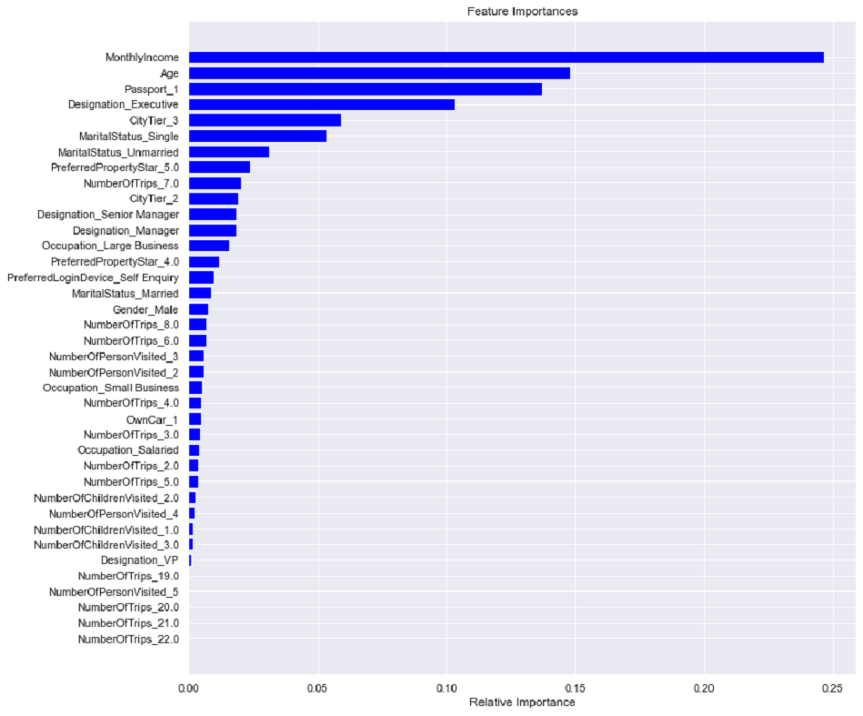
Feature Importance of Tuned Gradient Boost Classifier
Monthly Income,Age of customer,
having a passport and designation
of Executive are the important
features predicted by this model

Slide 20
Business Recommendations and Insights
We can use the model to predict which customers will buy the travel package when offered
As per the model suggestions the company should target customers with monthly income of up to 40,000 and Age below 40
Those in city tier 3 can be target for marketing as suggestions show they have higher chance of purchasing the travel package
Also customers who are in Manager designation has to be target for Marketing
Customers who are single are showing greater chances of purchasing the package
Having a passport ,owning a car ,having a business are few other factors which leads customers into buying a travel package
Those customers who prefer 5 star properties can also be targeted to buy travel package
Factors from customer interaction data which will boost the chances of the customer buying the travel package that needs to be considered are:
Having a higher duration of pitch by salesman to the customer
Getting a PitchSatisfactionScore of 3 or 5
Having ,multiple follow ups with the customer.Having 6 follow ups with the customer showed a good chance of the customer purchasing the travel package

